Slide 1
Service & Notification

Slide 2
Serivce

Slide 3
Description
Run without interaction with user
Need to define <service> in AndroidManifest.xml
Eg: <service android:name="com.example.serviceexample.MyService" />
Tell the system we would like to run something in background

Slide 4
Status of Services
Started: call StartService() to activate service
Bound: call BindService() for sending request or receive response

Slide 5
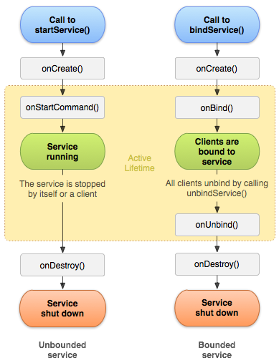
Service Lifecycle

Slide 6
Example
public class MyService extends Service { public static final String TAG = "MyService"; @Override public void onCreate() { super.onCreate(); Log.d(TAG, "onCreate() executed"); } @Override public int onStartCommand(Intent intent, int flags, int startId) { Log.d(TAG, "onStartCommand() executed"); return super.onStartCommand(intent, flags, startId); } @Override public void onDestroy() { super.onDestroy(); Log.d(TAG, "onDestroy() executed"); } @Override public IBinder onBind(Intent intent) {. //use for system request return null; } }

Slide 7
Notification

Slide 8
Basic flow
Create a NotificationManager object
Create Builder object for setting the notification syntax
Call Builder.build() to get NotificationCompat object
Use NotificationManager to execute notify()

Slide 9
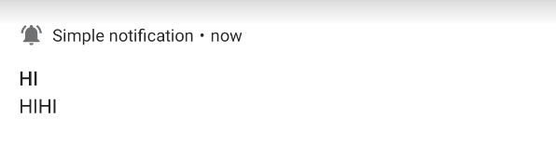
Basic compoments
2
1
3
4
Small icon
App Name
Title
Content

Slide 10
Set the content
NotificationCompat.Builder builder = new NotificationCompat.Builder(this, CHANNEL_ID) .setSmallIcon(R.drawable.notification_icon) .setContentTitle(textTitle) .setContentText(textContent) .setPriority(NotificationCompat.PRIORITY_DEFAULT);

Slide 11
Channel for notification
After Android 8, we need to setup a channel for notification
Multiple channels are allowed to show different kinds of message in the same app

Slide 12
Code
public void createChannel(){
String NOTIFICATION_CHANNEL_ID = "my_channel_id_01"; notificationManager = (NotificationManager) getSystemService(Context.NOTIFICATION_SERVICE); if (Build.VERSION.SDK_INT >= Build.VERSION_CODES.O) { //check version NotificationChannel notificationChannel = new NotificationChannel(NOTIFICATION_CHANNEL_ID, "My Notifications", NotificationManager.IMPORTANCE_DEFAULT); // Configure the notification channel. notificationChannel.setDescription("Channel description"); notificationManager.createNotificationChannel(notificationChannel); } }

